Slide 1
National Grid Code Jam

Slide 2
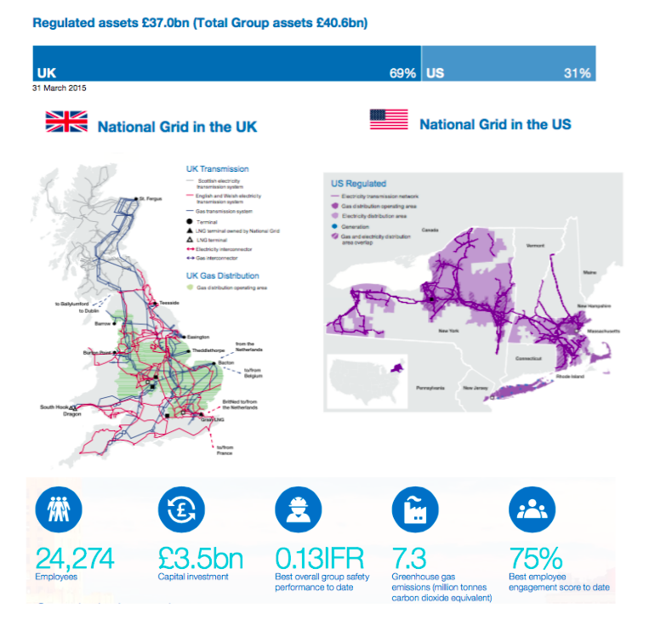

Slide 3
ngLabs are a small team who build working prototypes to test the value of new technology
Bridge the gap between new technology hype and practical hands-on experimentation
Provide proof of concepts for business experimentation
Successful trials will result in a business case for further development either by the Labs team or Solution Delivery
Principles: Rapid Development, MVP, succeed/fail fast
National Grid ‘labs’
Delivery
Ideation
Experiment
Productionize
Crowd sourcing
Create working prototypes
Tech. market scanning
Deliver final production solutions that are re-usable across the enterprise
Business needs
Develop proposals
Innovation workshops
Integrate existing partner solutions
Disruptive tech owners

Slide 4
Keyhole
One of our major
Gas Distribution Projects

Slide 5
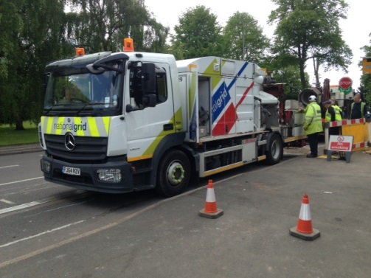

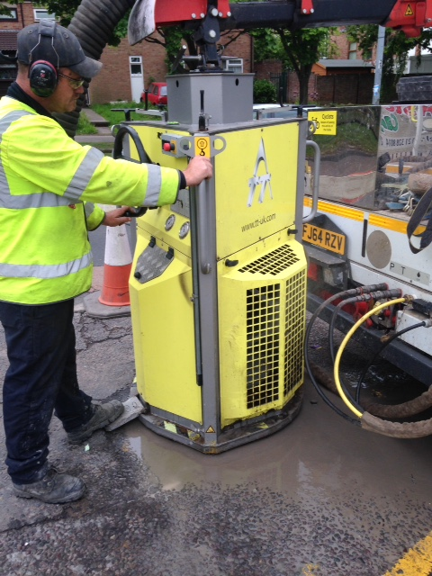
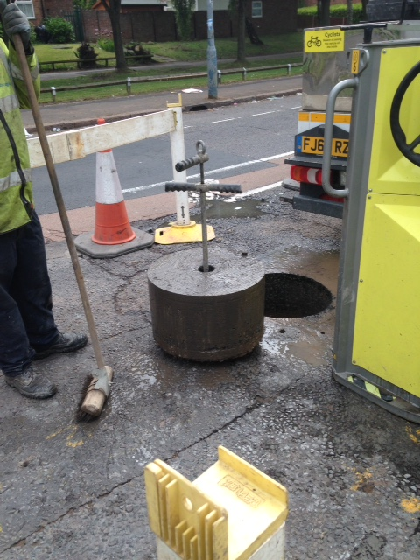
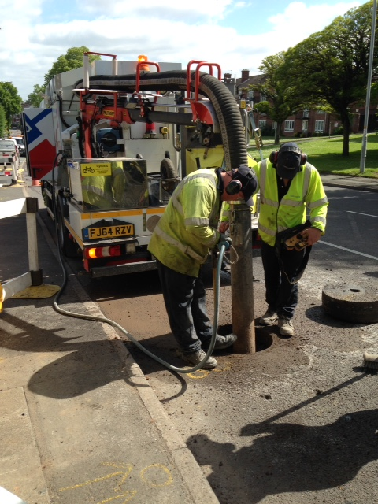
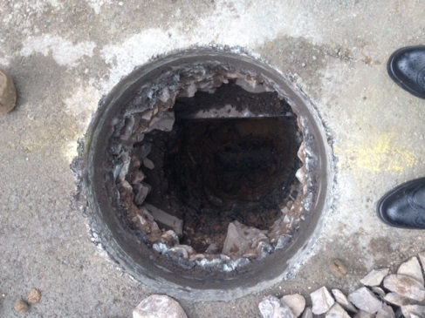
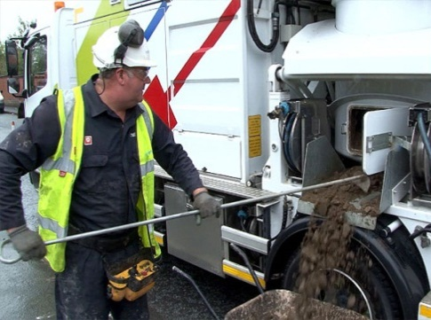
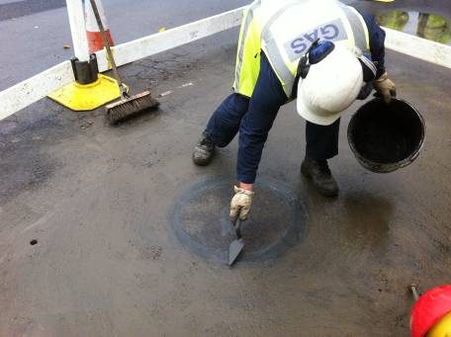
Keyhole Process

Slide 6
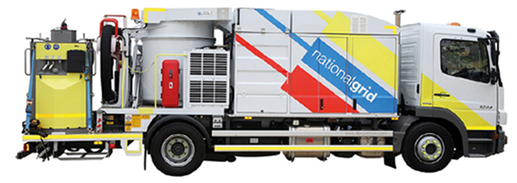
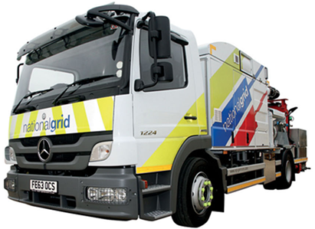
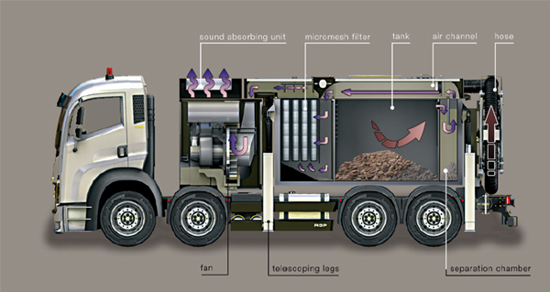
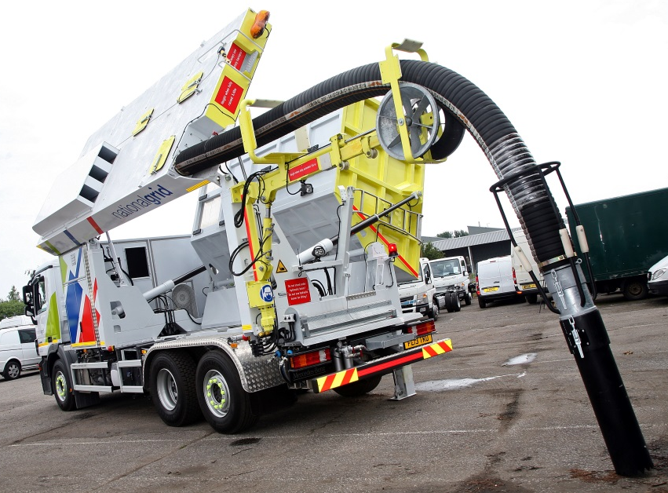
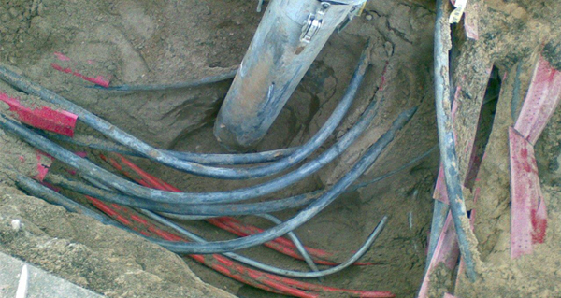
CitySuckers
Vacuum Excavators

Slide 7
Operations Field Force
Gas Distribution

Slide 8
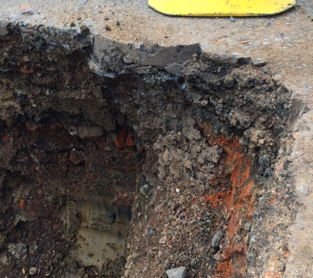

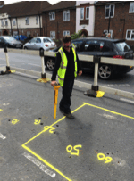

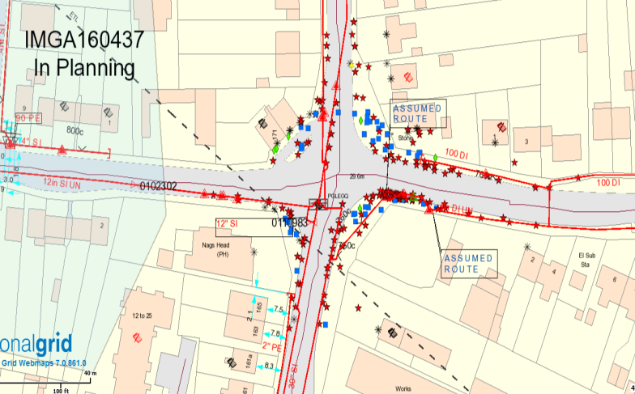
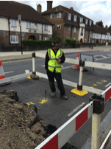
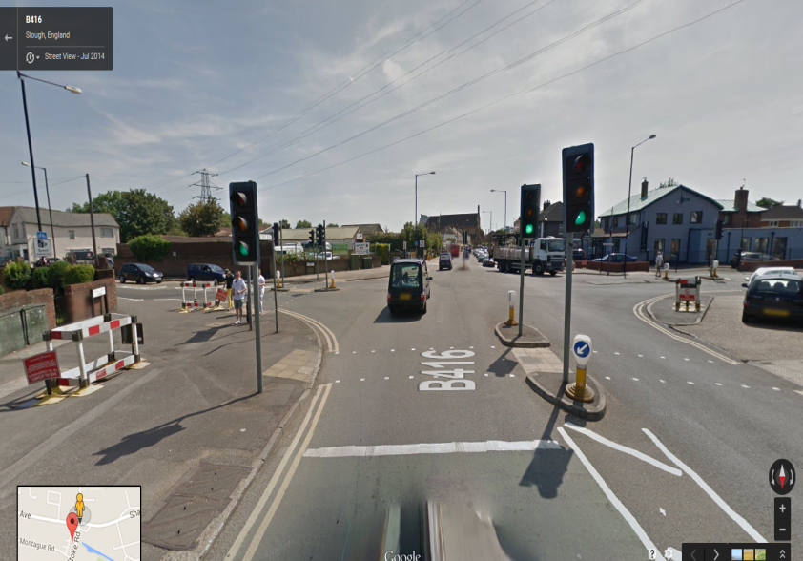
Gas Distribution Repair Teams
This text box and image can be deleted and replaced with your own selection from Brand Central’s image library.

Slide 9
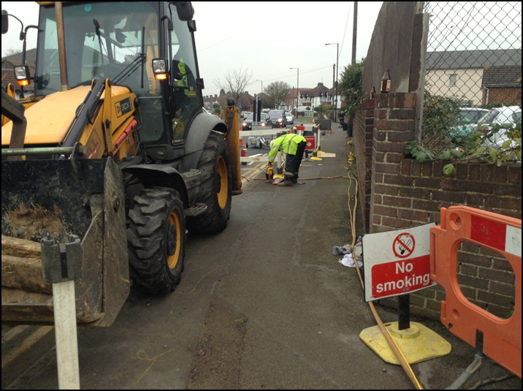
What our Field Force want
Quick and simple
For use in all weathers
GPS enabled with a field to identify site.
Improve site safety
Remove the need for physical measurements
Easy Data Collection
Adaptability (The Swiss Army Knife Approach)

Slide 10
Rules of the Jam

Slide 11
National Grid Code Jam
Problem Statement – Engineers manually measure the excavation inaccurate and generally too much reinstatement has been ordered which generates .
Scope - Engineers in the field need to use the iPad, scanner and laptop to take a 3D model of the excavation to manually calculate size and volume
IPR – National Grid will own the IPR.

Slide 12
National Grid Code Jam - Timescales

Slide 13
National Grid Code Jam - Judging Metric
3 Necessities (must be met)
- Must run on an iPad
Must calculate the volume of a 3D model
Must be lightweight enough to use in the field (i.e. not too data heavy)
5 Point Scale (each out of 10)
UI Friendliness/Ease of use
Innovative
Performance
Data consumption
Accuracy of the calculation
Bonuses (+5 points each)
- Provide dimensions
- Asset identification
- GPS Metadata
- Bonus for innovative ideas

